Slide 1

FACE RECOGNITION USING Siamese CNN
By Ross Erskine (ppxre1)

Slide 2

Content
Introduction
Feature space
Challenges
Objective of Project
Architecture
Training
Evaluation
Further work
References

Slide 3
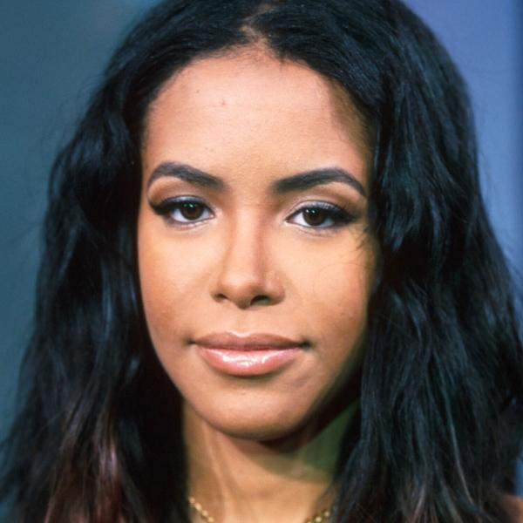
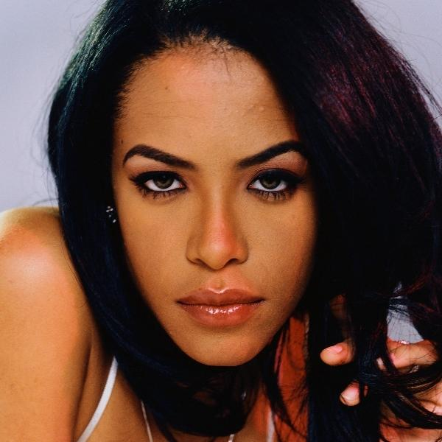
Introduction
Face recognition
Notes:
Click 1: the task of identifying two or more faces form an image or video
what features can we use to identify images to be the same person,
Hair? Eyebrows?

Slide 4
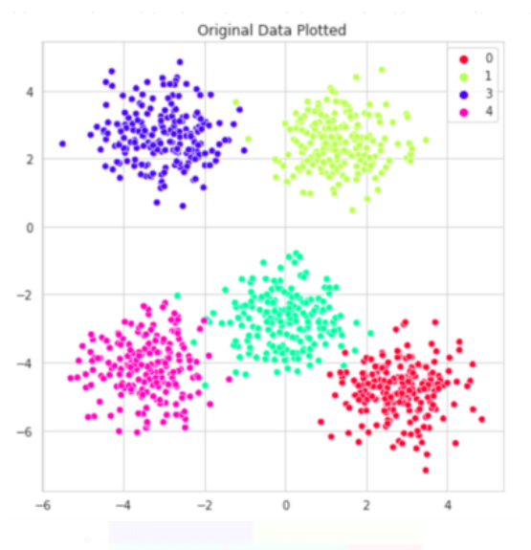
Feature space
https://towardsdatascience.com/visualizing-how-different-ml-models-operate-in-the-feature-space-c6caa8a96375
Notes:
One way is by giving each its own place in feature space by giving each image an encoding that is grouped together by similar images of the same class
And non similar images that are further away such that when the encodings are compared, we can give each match a similarity score.

Slide 5
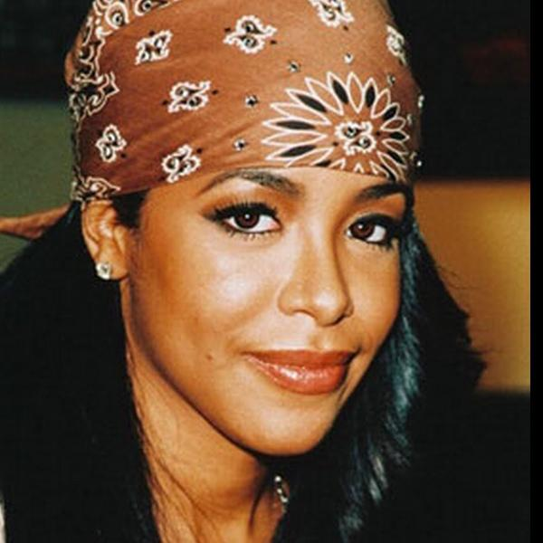

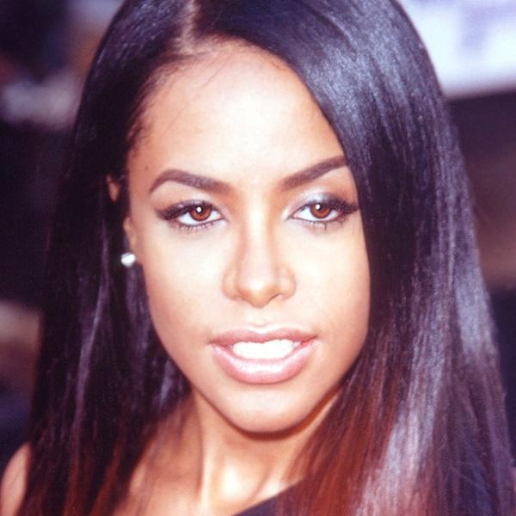
Challenges
https://towardsdatascience.com/visualizing-how-different-ml-models-operate-in-the-feature-space-c6caa8a96375
Notes:
And there are many challenges Such as
Click one: lighting/ illumination
Click two: Occlusion
Click 3: Occlusion
Click 4: single class if there is only one image for that class that unique encoding in feature space can be small and can get too close to other spaces and get lost. The idea would be to make that space bigger perhaps with more images or further away from other spaces making the encoding more unique

Slide 6
Objective of this project
Create a model that learns Face recognition of pairs of images
Create encodings in feature space to determine similarities and dissimilarities
Prepare datasets for encodings
Test model
Evaluate for improvements

Slide 7
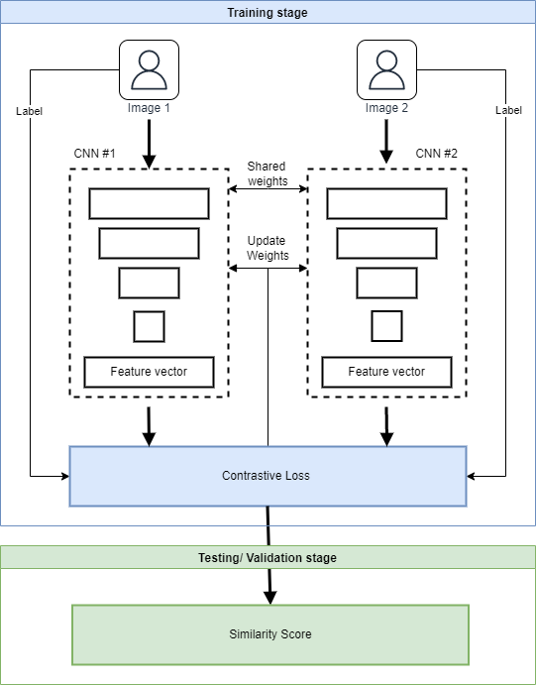

Architecture
Siamese Network
R. Hadsell, S. Chopra, and Y. LeCun, “Dimensionality Reduction by Learning an Invariant Mapping,” in 2006 IEEE Computer Society Conference on Computer Vision and Pattern Recognition (CVPR’06), June 2006, vol. 2, pp. 1735–1742, ISSN: 1063-6919
Notes:
Can be computationally expensive as you train pairs of images
In fact we create Siamese batches along with k-fold cross validation
Contrastive loss Dw is the Euclidean distance between vectors X1 X2
The Similarity score used is also Euclidean distance

Slide 8
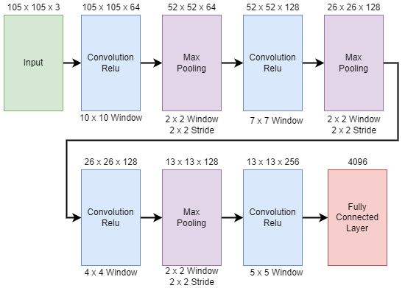
Architecture
https://uk.mathworks.com/help/deeplearning/ug/train-a-siamese-network-to-compare-images.html
Notes:
This was my first architecture used when I set the model up
4 convolutions with ReLu activation, 3 max Pooling layers and a FC output layer
I used this architecture to start with however I wanted to use a well known architecture, one that was not too deep that as too slow down training
Also I tried a AlexNet with Transfer learning using weights already trained but becouse the the input was 227x 227 I could only train on my CPU and got very low accuracy.
I also tried Simplified VGG although that did not work the way I wanted so I changed to this architecture they were giving me low accuracy scores
So I lost faith in them although the problem could have been the amount of time needed to train these architectures.
I went back to an architecture that seemed to be giving me better results

Slide 9
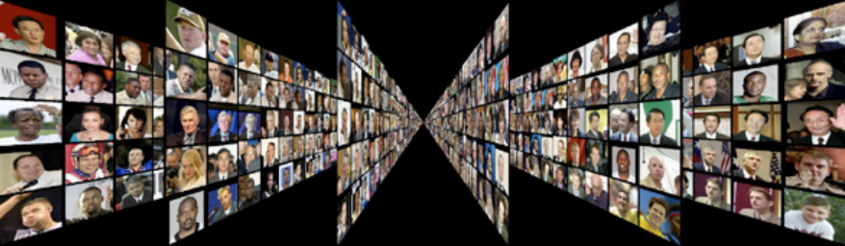
Training - Stage one
Labelled faces in the wild (LFW)
http://vis-www.cs.umass.edu/lfw/
Notes:
1300 images with 1680 of two or more in each class
Aligned and deep funnelled for preparation for deep networks
Although the dataset low on high lighting, strong occlusion it seems sufficient for this project.

Slide 10



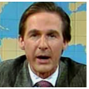
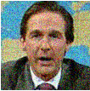

Training – Stage two
Original
Blur
Flip
Shear
Grain
Scale
Notes:
I wanted to create pairs of images to enlarge the feature space for each of the sets images
Blur is using Gaussian filter with random smoothing
Flip is using random
Shear shears horizontal transformation in range of -30 to 30
Grain using Gaussian Noise
Scale randomly transforms image horizontal and vertical the same
I could have used more however I was restricted by the memory size of my GPU
I could improve this by using the images as a Image data store

Slide 11
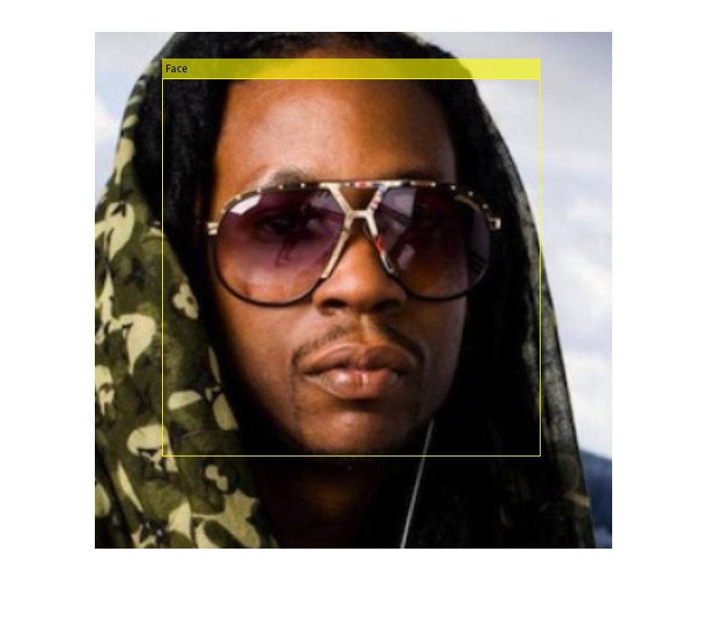
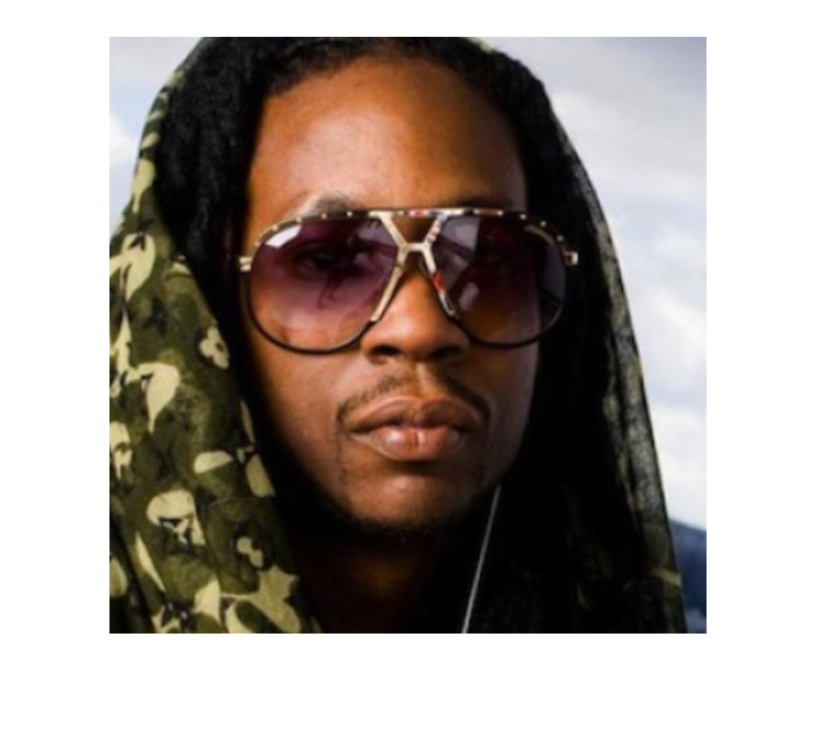
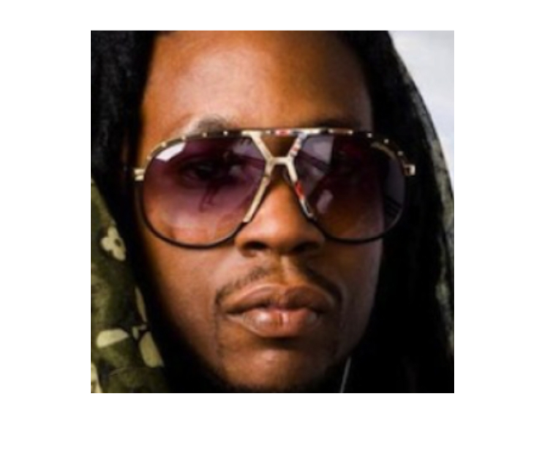
Data-set
Cascade object detection
Notes:
Paper by Viola jones; Rapid object detection using a boosted cascade of simple features
Click 1: image 1
Click 2: Bonding box
Click 3: cropped image

Slide 12
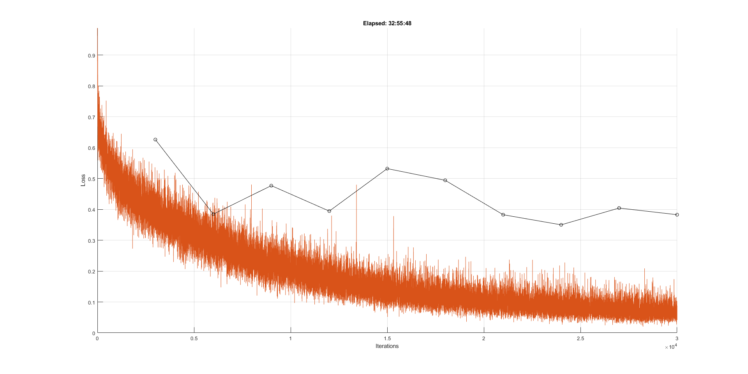
Evaluation
Notes:
13233 images with 5749 people, 4069 single images and 1680 with two or more images leaves 9164
So the combination of possible pairs is 42 million iterations
Was 300k iterations
This is the training from Run 1 of the LFW dataset
Combinations of pairs would be 1.4 million
With batch size of 64 with 50% similar pairs 44k iteration
Look at all combinations 84million which is 2.6m iterations

Slide 13
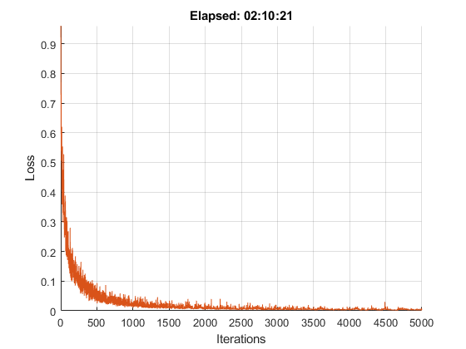
Evaluation
Notes:
This is Run 1 of training with augmented sets
600 set size 179700 / 32 batchsize = 5615 iterations

Slide 14
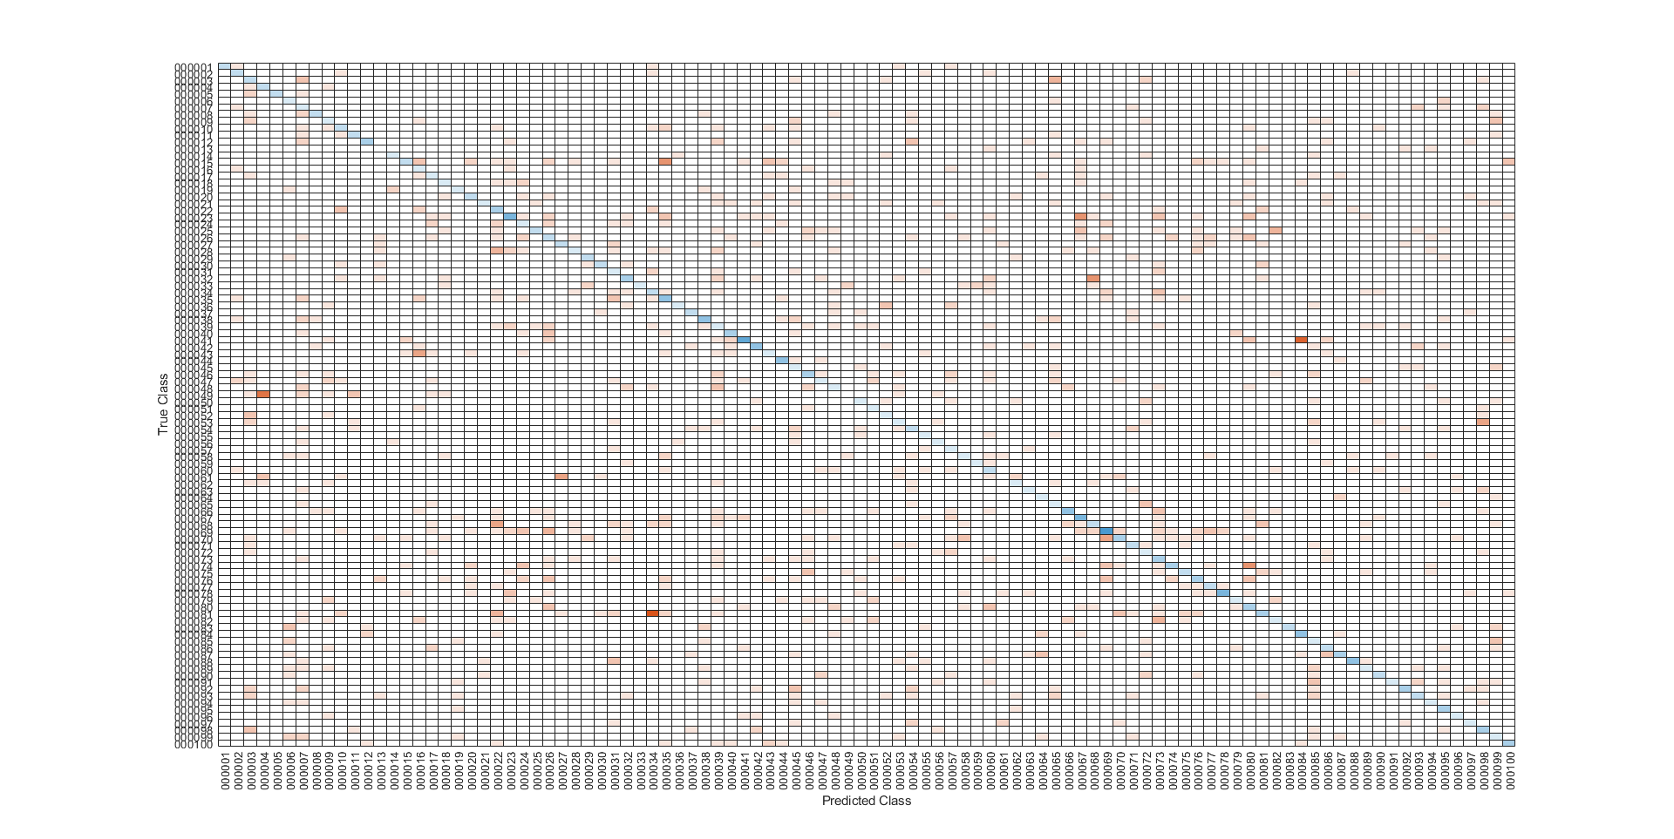
Notes:
This the confusion map obviously not brilliant
Although I feel I under estimated the time it would take to train the LFW training set
With 13000 images and 1680 with more than on class you would need of easily over
I have a base version that gives me 25% without the extra LFW dataset

Slide 15
Further work
Train model longer
Train with possibly less images
Augment stage one LFW Images
use a well-known architecture such as AlexNet
Use Image Data Store for Stage two, to better computation.
Look further into work on occlusions such as: Lingxue Song, Dihong Gong, Zhifeng Li, Changsong Liu, and Wei Liu, “Occlusion Robust Face Recognition Based on Mask Learning with PairwiseDifferential Siamese Network,” arXiv:1908.06290 [cs], Aug. 2019,arXiv: 1908.06290

Slide 16
References
[1] https://towardsdatascience.com/visualizing-how-different-ml-models-operate-in-the-feature-space-c6caa8a96375
[2] https://uk.mathworks.com/help/deeplearning/ug/train-a-siamese-network-to-compare images.html
[3] R. Hadsell, S. Chopra, and Y. LeCun, “Dimensionality Reduction by Learning an Invariant Mapping,” in 2006 IEEE Computer Society Conference on Computer Visioand Pattern Recognition (CVPR’06), June 2006, vol. 2, pp. 1735–1742, ISSN: 1063-6919.
[4] http://vis-www.cs.umass.edu/lfw/
[5] P. Viola and M. Jones, “Rapid object detection using a boosted cascade of simple features,” in Proceedings of the 2001 IEEE Computer Society Conference on Computer Vision and Pattern Recognition. CVPR 2001, Dec.2001, vol. 1, pp. I–I, ISSN: 1063-6919.
[7] Lingxue Song, Dihong Gong, Zhifeng Li, Changsong Liu, and Wei Liu, “Occlusion Robust Face Recognition Based on Mask Learning with PairwiseDifferential Siamese Network,” arXiv:1908.06290 [cs], Aug. 2019, arXiv: 1908.06290

